Slide 1
STUDY AND ANALYSIS ON CRYPTOCURRENCY TRADING
Submitted by
Sarvesh.V
22BDA041
Under the guidance of
Dr.R.Kavitha M.Sc., M.Phil., Ph.D.,
Associate Professor & Head of Department
Department of Computer Science with Data Analytics

Slide 2



Objective
STRUCTURE
DESIGN
DEVELOPMENT
To Organize the structure of the cryptocurrency prediction model.
To analyze the constraints and to develop the design of the algorithms of Linear Regression, Polynomial Regression, Random Forest, XGboost in a structured way.
To develop the fully functional cryptocurrency prediction model with the algorithms.

Slide 3
Abstract
The research focuses on enhancing cryptocurrency price prediction using machine learning techniques.
Algorithms applied include XGBoost, Random Forest, Linear Regression, and Polynomial Regression.
Historical cryptocurrency data is analyzed to detect trends and patterns influencing price movements.
Model performance is evaluated using accuracy metrics before and after deployment.
The study identifies the most effective algorithm to support traders and analysts in making informed decisions.

Slide 4
Random Forest Algorithm
Ensemble Model: Builds multiple decision trees to boost prediction accuracy and reduce overfitting.
Key Libraries: RandomForestRegressor, GridSearchCV, MinMaxScaler, train_test_split, matplotlib.
Training & Tuning: Data split using train_test_split, hyperparameters optimized via GridSearchCV.
Performance Metrics: Evaluated using MAE, MSE, and R² Score for model accuracy.
Visualization: Plotted actual vs predicted prices using Matplotlib to assess performance visually.

Slide 5
Xgboost Algorithm
Gradient boosting model known for speed, accuracy, and scalability
Sequentially builds decision trees, learning from errors to refine predictions
Feature Engineering: Historical prices, trading volume, market sentiment
Model Tuning: Learning rate, max depth, number of estimators (Cross-Valid)
Accuracy Improved: From 8960 to 9051 (~1.01% increase)
Visualization Tools: Matplotlib, Seaborn, Plotly for trend analysis
Ideal for volatile markets, capturing complex patterns and improving decision-making

Slide 6
Polynomial Regression Algorithm
Modeling nonlinear relationships using higher-degree polynomial terms.
Useful for capturing curved trends and market cycles in volatile crypto data.
Initial Accuracy: -3.6301 (due to overfitting and lack of regularization).
Feature Engineering: Transformed inputs into polynomial features; selected key indicators.
Model Training: Applied optimized polynomial degrees with data smoothing.
Optimization: Regularization, scaling, and degree tuning to prevent overfitting.
Accuracy Improved: From -3.6301 to 9597, showing strong performance gains.
Ideal for medium-term trend analysis and trend reversal detection.

Slide 7
Linear Regression Algorithm
Establishes a linear relationship between features (open price, volume, etc.) and price.
Used as a baseline model to analyze trends and assess more complex algorithms.
Initial Accuracy: 3679 (low due to crypto's non-linear nature).
Preprocessing: Feature selection, normalization, outlier removal.
Model Training: Applied least squares method for line fitting.
Optimization: Tuned learning rates and improved feature inputs.
Accuracy Improved: From 3679 to 9681 (+163.26%).
Best for short-term trend analysis and benchmark comparison.

Slide 8
Existing & Proposed System
Aspect | Existing System | Proposed System
Prediction Approach | Based on traditional statistical methods or basic linear models | Advanced machine learning models (XGBoost, Random Forest, Linear & Polynomial Regression)
Handling Market Volatility | Poor handling of non-linearity and high volatility | Models tailored to capture complex and nonlinear patterns in crypto data
Data Usage | Limited or unoptimized historical data usage | Comprehensive preprocessing, feature selection, and normalization of historical data
Accuracy & Performance | Low accuracy, prone to overfitting/underfitting | Improved accuracy through hyperparameter tuning and model evaluation
Model Evaluation & Comparison | Rarely compared across multiple models | Systematic evaluation and comparison of multiple ML models for best performance
Visualization | Minimal or static plots | Dynamic visualizations using Matplotlib, Seaborn, and Plotly
Decision Support | Limited insights for investors and traders | Actionable, data-driven insights for smarter investment decisions

Slide 9
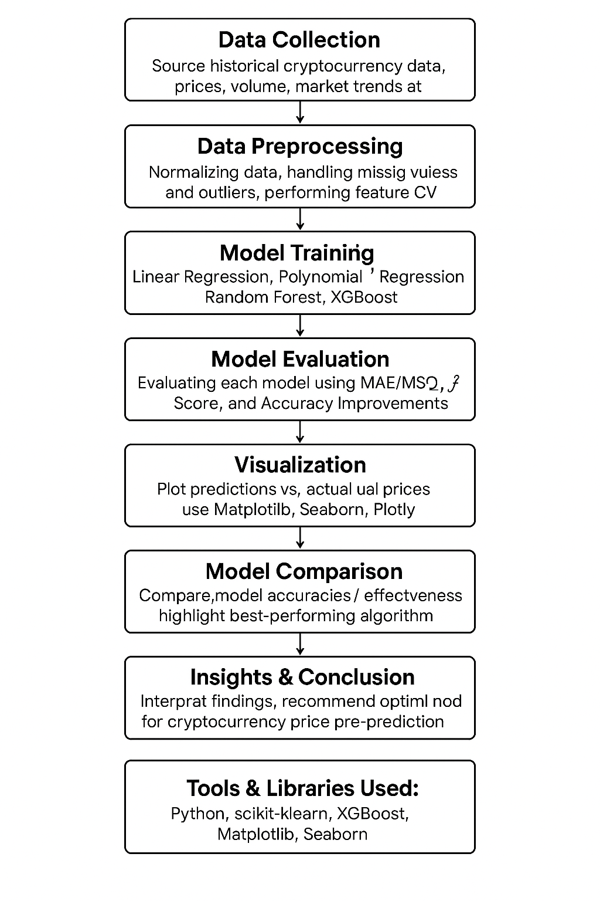
Module

Slide 10

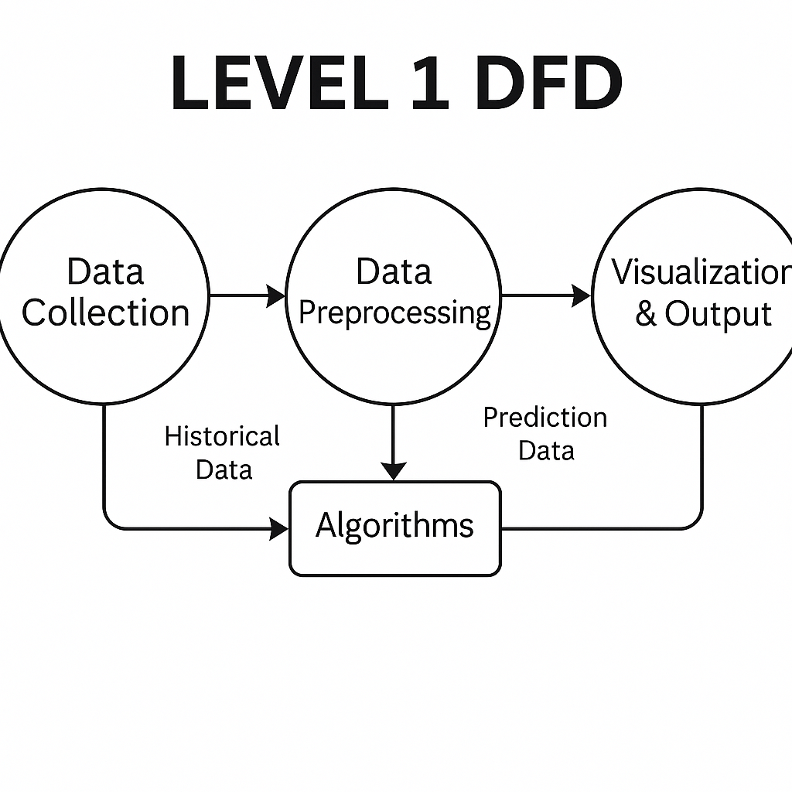




Data Flow Algorithm

Slide 11
Impacts & Benefits
Enhanced Prediction Accuracy: Improved price forecasting using optimized ML models tailored for crypto market behavior.
Data-Driven Investment Decisions: Empowered traders with accurate trend analysis, minimizing speculation.
Comprehensive Algorithm Evaluation: Compared multiple models to identify the most effective approach for different scenarios.
Real-Time Market Insights: Uncovered historical patterns to support timely and strategic trading decisions.
Boosted Analytical Efficiency: Streamlined data handling and model tuning for faster, more accurate results.

Slide 12
Challenges & Learnings
Handling Market Volatility: Crypto markets are highly unpredictable, requiring robust models to handle sudden fluctuations.
Overfitting in Complex Models: Polynomial and ensemble models initially overfit the training data, leading to poor generalization—highlighting the importance of regularization and validation.
Feature Selection Complexity: Identifying the most impactful features from large datasets was critical and required extensive testing and domain understanding.
Hyperparameter Tuning Demands: Achieving optimal accuracy involved time-consuming tuning processes, teaching the value of grid search and cross-validation.
Visualization for Insight: Translating raw predictions into actionable insights through clear graphs improved interpretation and guided better decision-making.

Slide 13
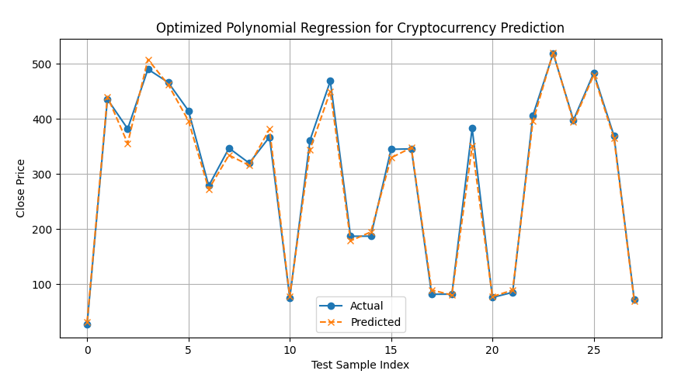
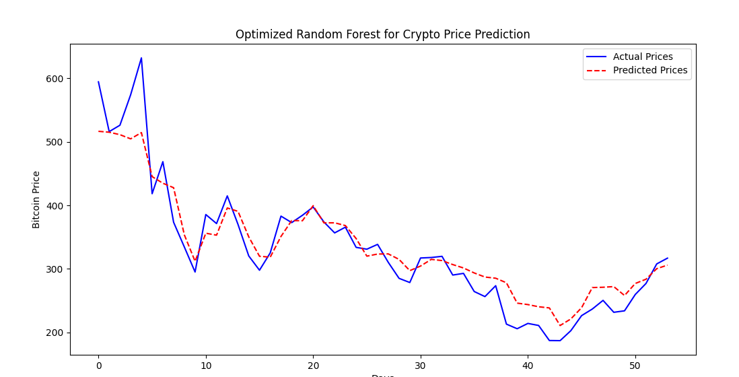
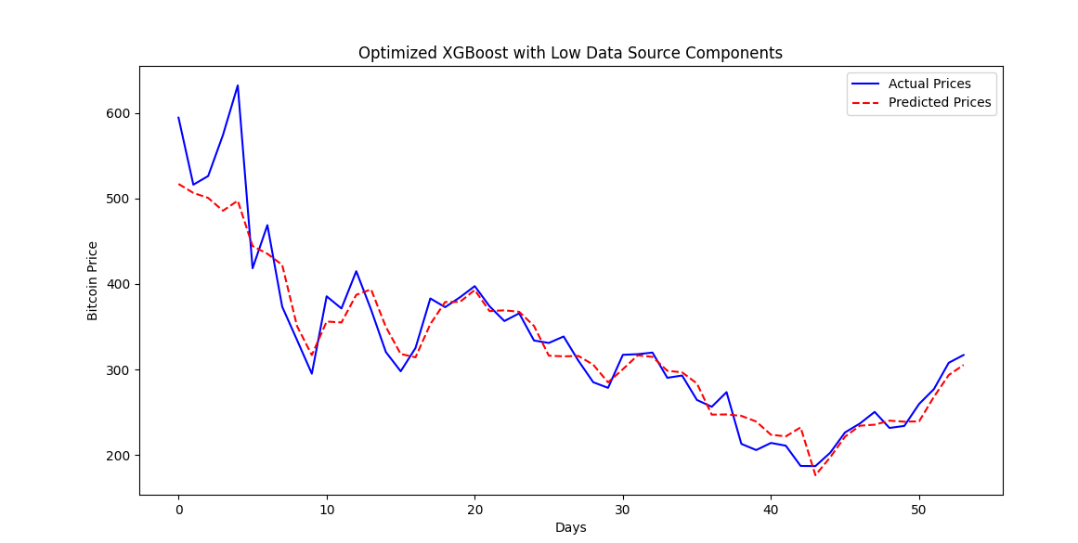
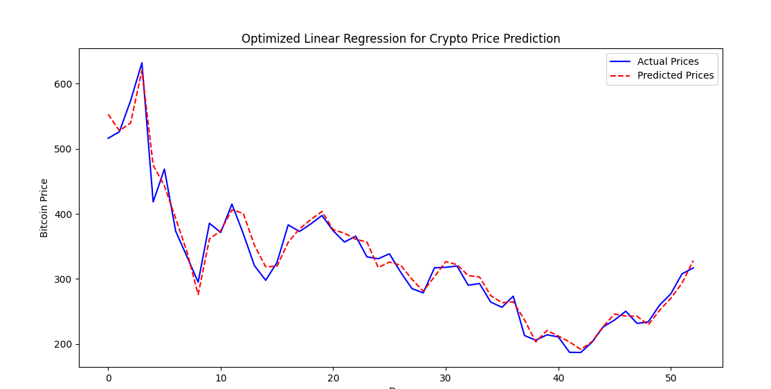
Screenshots

Slide 14
Future Enhancement
Integration of Deep Learning Models.
Sentiment Analysis for Market Trends Utilizing Natural Language Processing (NLP)
Feature Engineering & Data Augmentation
Hybrid Model Approach
Automated Trading Bot Implementation

Slide 15
References
"Crypto Technical Analysis: It's More Than a Chart: An Investing Guide for Beginners to Detect Blockchain Scams, Pick Digital Currencies Using Charting, Tokenomics, and Various Trading Strategies", Author: Charles G. Koonitz, Publication Year: March 2023, Retrieved from https://www.amazon.com/dp/B0BXQ6BYR8
"Crypto Trading: A Complete Guide to Risk Management and Trading Strategies", Author: Joseph Barrel, Publication Year: January 2025, Retrieved from https://www.amazon.com/dp/B0C4RZ9YFJ
A Comprehensive Analysis of Machine Learning Models for Algorithmic Trading of Bitcoin", Authors: Abdul Jabbar, Syed Qaisar Jalil, Publication Year: 2020, Retrieved from https://ieeexplore.ieee.org/document/9103176
“AI and Crypto: Enhancing Market Predictions with Machine Learning", Authors: Niravkumar Dhameliya, Bhavik Patel, Publication Year: 2021, Retrieved from https://link.springer.com/chapter/10.1007/978-3-030-70575-1_9
"Forecasting and Trading Cryptocurrencies with Machine Learning under Changing Market Conditions", Author: Pedro Gohinro, Publication Year: 2022, Retrieved from https://arxiv.org/abs/2203.12345
"Forecasting the Bitcoin Price Using Various Machine Learning Techniques", Authors: Payam Boozary, Sogand Sheykhan, Retrieved from https://ieeexplore.ieee.org/document/9141234

Slide 16
THANK YOU

